Slide 1
Classifying Children’s literature Books

Slide 2
Team members
Anas Elbattra
Ahmed Badawy
Esmael Ezz
Yousef Shindy

Slide 3
Business Case

Slide 4
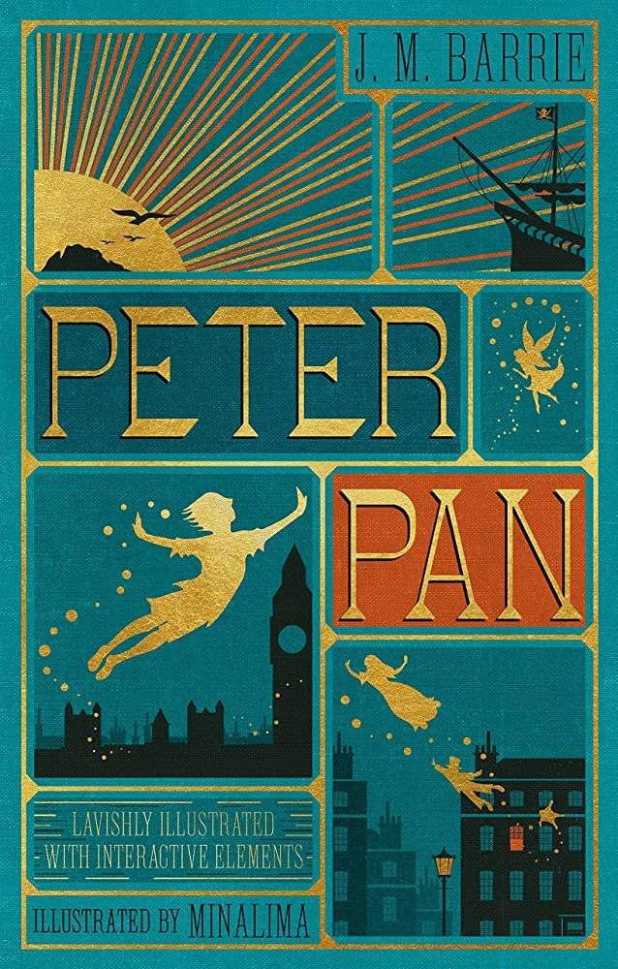
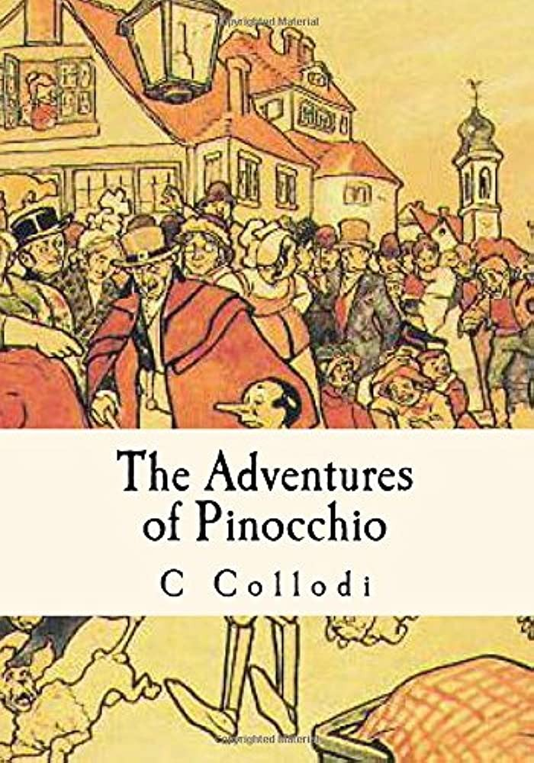
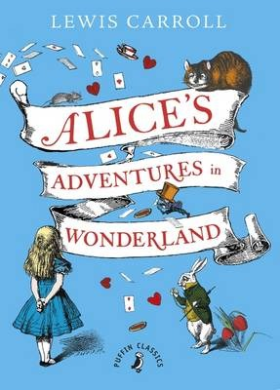
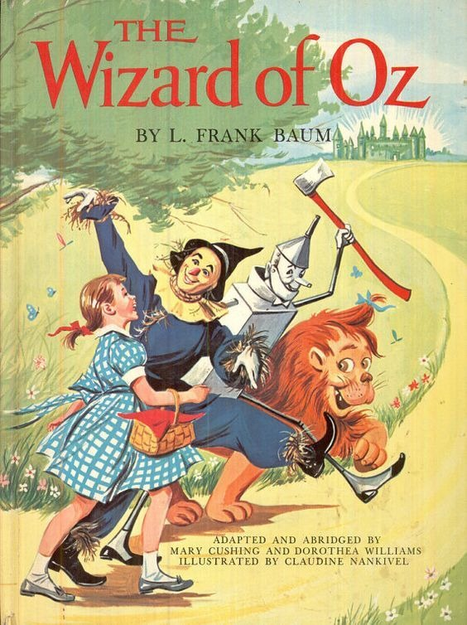
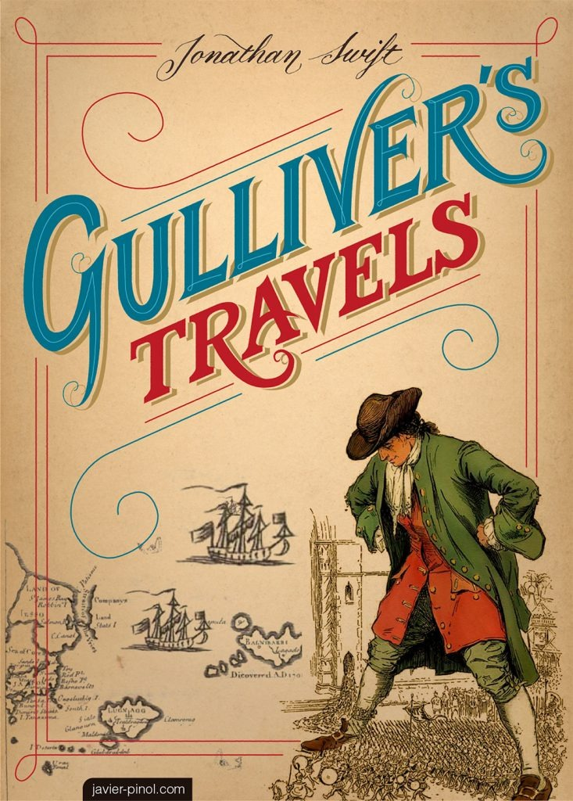
Books

Slide 5
Data
The Adventures of Pinocchio.
Peter Pan.
The Wonderful Wizard of Oz.
Alice’s Adventures in Wonderland.
Gulliver’s Travels.

Slide 6
Preprocessing
Tokenize The Book.
Remove Stop Words.
Split each book to 200 samples.
Lemmatization.
Combine the five books.

Slide 7
Feature Engineering
Bag of Words
TF-IDF
N-Gram

Slide 8
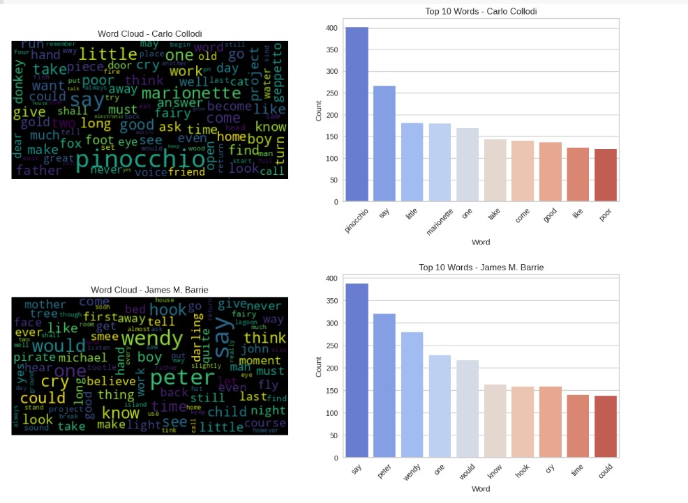
Visualization

Slide 9
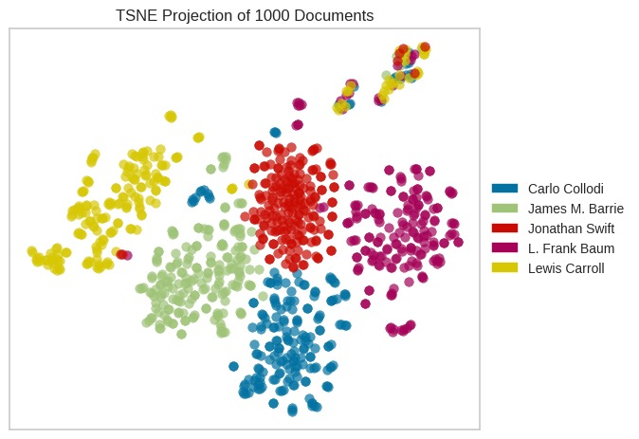
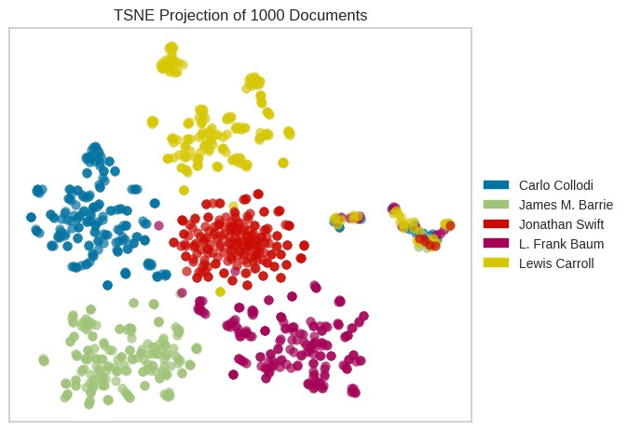
Visualization
Bag of Word
TFIDF

Slide 10
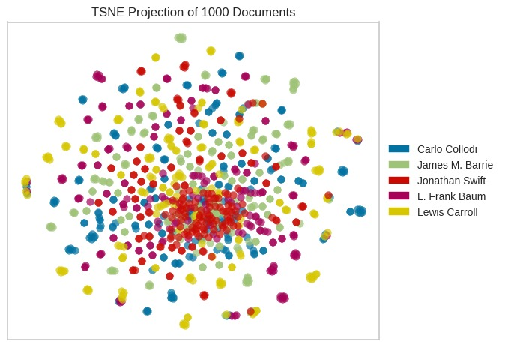
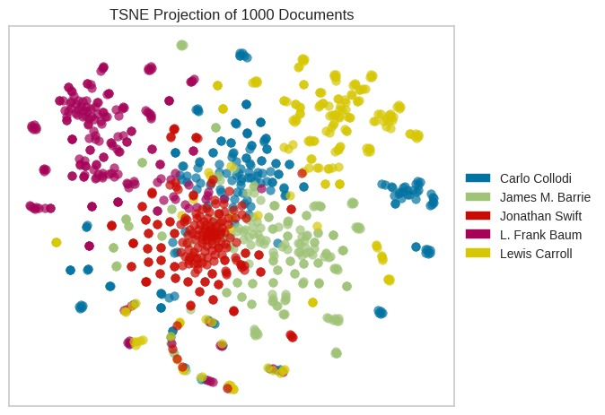
Visualization
Tri-Gram
Bi-Gram

Slide 11
Modelling
Model | Bag of Words | TFIDF | Bi-Gram | Tri-Gram
SVM | Accuracy: 0.96 F1 score: 0.97 | Accuracy: 0.96 F1 score: 0.97 | Accuracy: 0.82 F1 score: 0.83 | Accuracy: 0.71 F1 score: 0.73
Naïve Bayes | Accuracy: 0.96 F1 score: 0.97 | Accuracy: 0.96 F1 score: 0.97 | Accuracy: 0.95 F1 score: 0.95 | Accuracy: 0.88 F1 score: 0.88
KNN | Accuracy: 0.95 F1 score: 0.96 | Accuracy: 0.94 F1 score: 0.94 | Accuracy: 0.86 F1 score: 0.86 | Accuracy: 0.62 F1 score: 0.60
Random Forrest | Accuracy: 0.95 F1 score: 0.96 | Accuracy: 0.95 F1 score: 0.96 | Accuracy: 0.73 F1 score: 0.73 | Accuracy: 0.48 F1 score: 0.49
SGD | Accuracy: 0.97 F1 score: 0.97 | Accuracy: 0.96 F1 score: 0.96 | Accuracy: 0.92 F1 score: 0.92 | Accuracy: 0.79 F1 score: 0.80
XGB | Accuracy: 0.95 F1 score: 0.95 | Accuracy: 0.95 F1 score: 0.95 | Accuracy: 0.83 F1 score: 0.83 | Accuracy: 0.75 F1 score: 0.75
BERT | Accuracy: 72.5

Slide 12
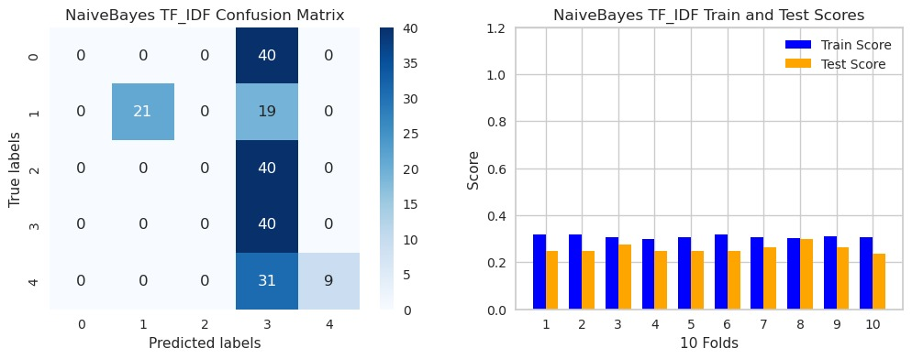
Error Analysis

Slide 13
Thank you

